Slide 1
Restricted use
Rules, Remarks and notes
This project reference can only be use in a restricted manner
You are allowed to show this project reference
You are not allowed to hand out this project reference
And you are also not allowed to publish it
If you want to present this reference to an audience, talk to Marketing

Slide 2


WE CREATED A GLOBAL INFORMATION LANDSCAPE
ADAMA – KNOWLEDGE HUB

Slide 3

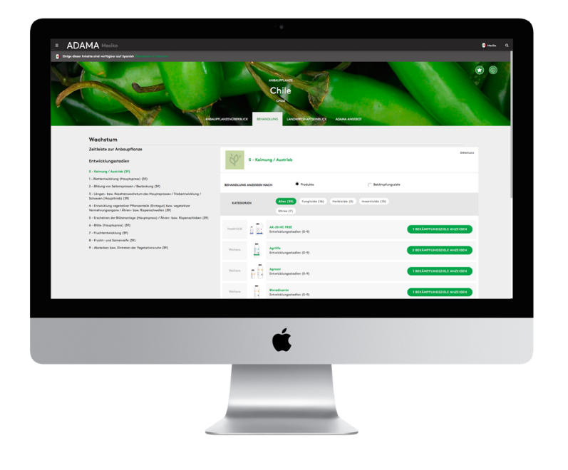
ADAMA
KNOWLEDGE HUB
UX / UI
Conception
Project Plan
Architecture
Goal: Make global knowledge accessible to customers and experts throughout the workforce. Reduce product development cycles and boost worldwide registration processes. Allow for an strategic planning of target markets and products.
Solution: PRODYNA provided a simple way of evaluating and processing complex data in real-time, based on an ergonomic web-portal. Products, formulas as well as targets can be selected by markets and registration status and strategic decisions can be triggered in real time.

Slide 4
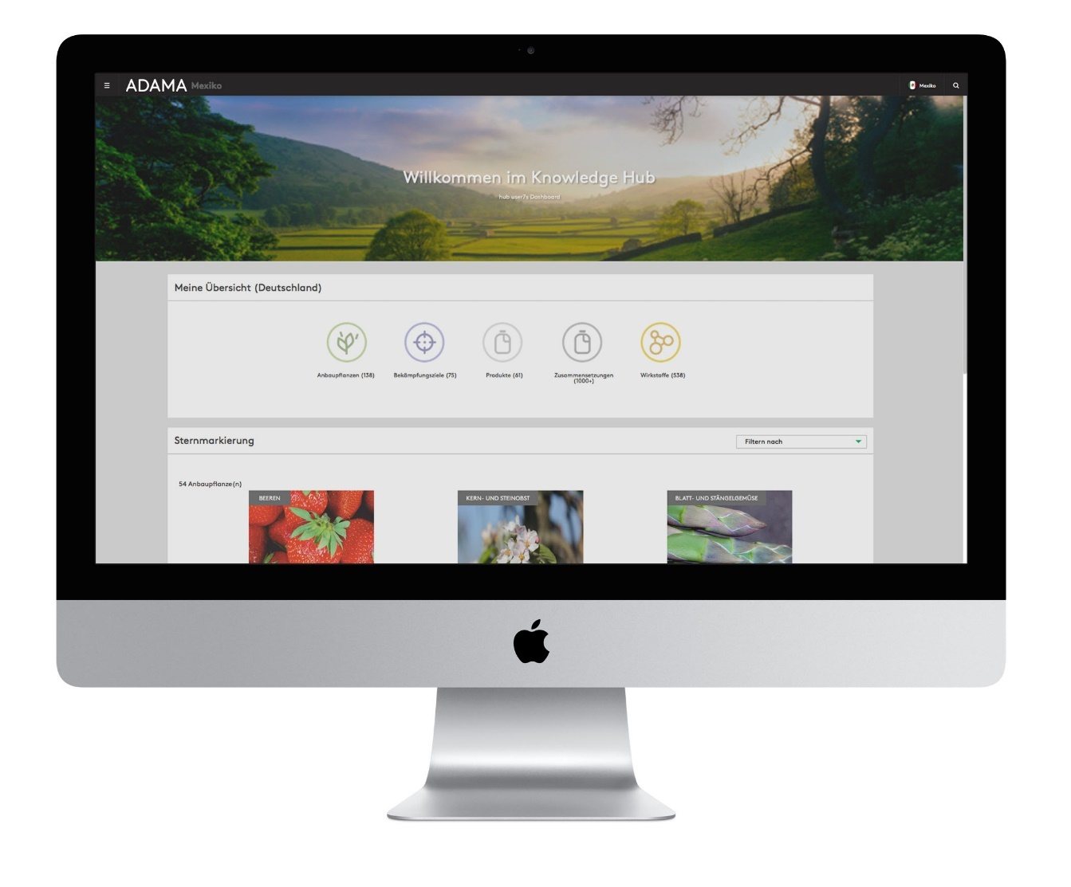

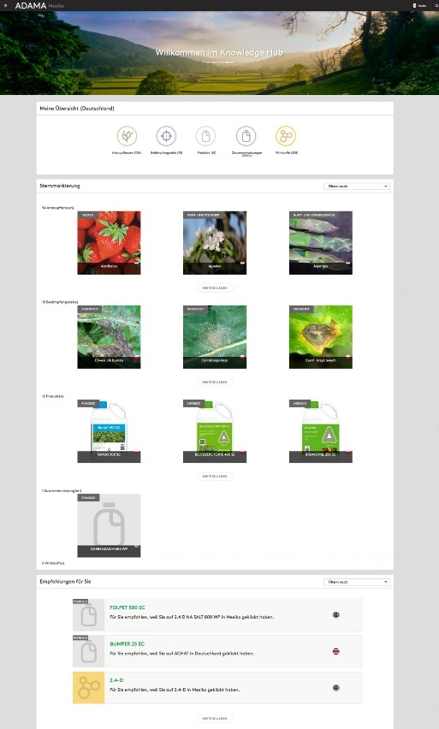
ADAMA
KNOWLEDGE HUB

Slide 5
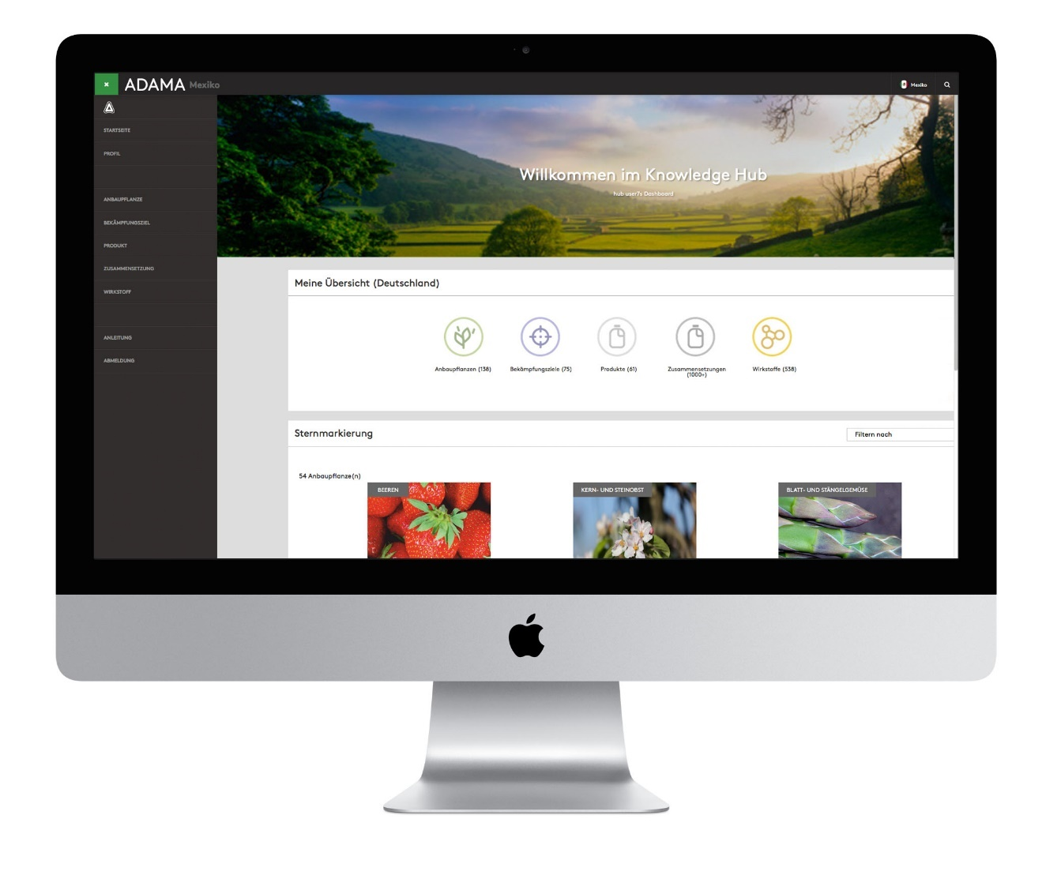
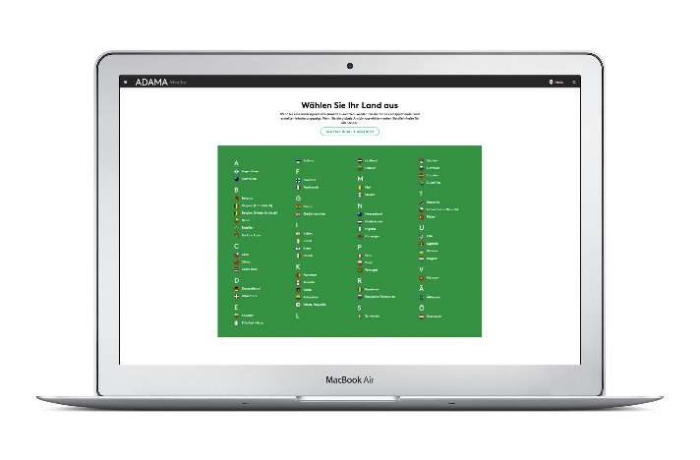
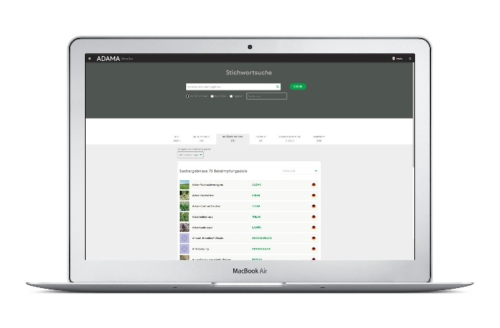
ADAMA
KNOWLEDGE HUB

Slide 6
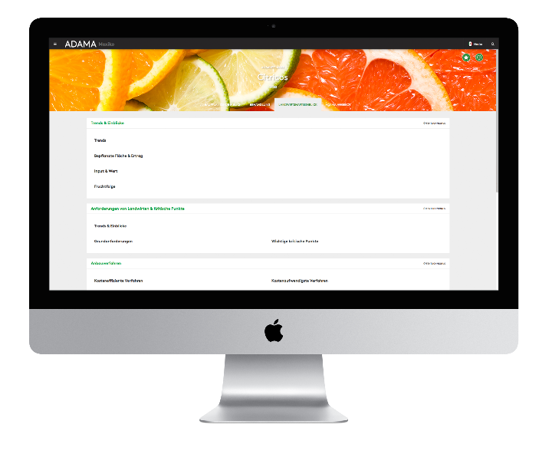
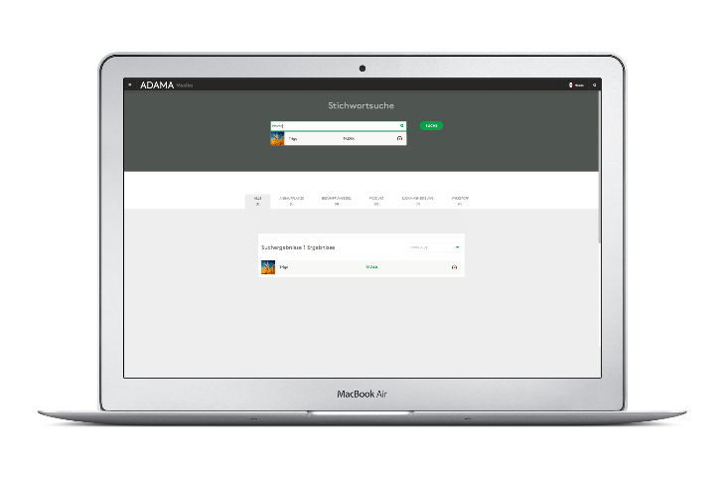
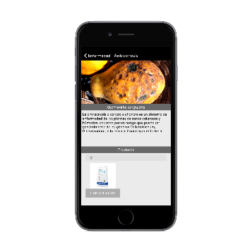
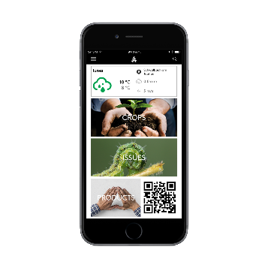
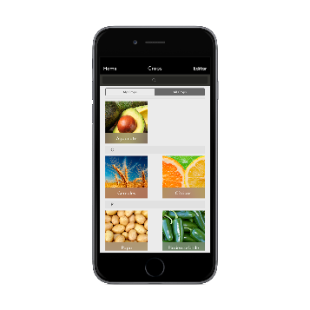
ADAMA
KNOWLEDGE HUB – RESPONSIVE DESIGN

Slide 7
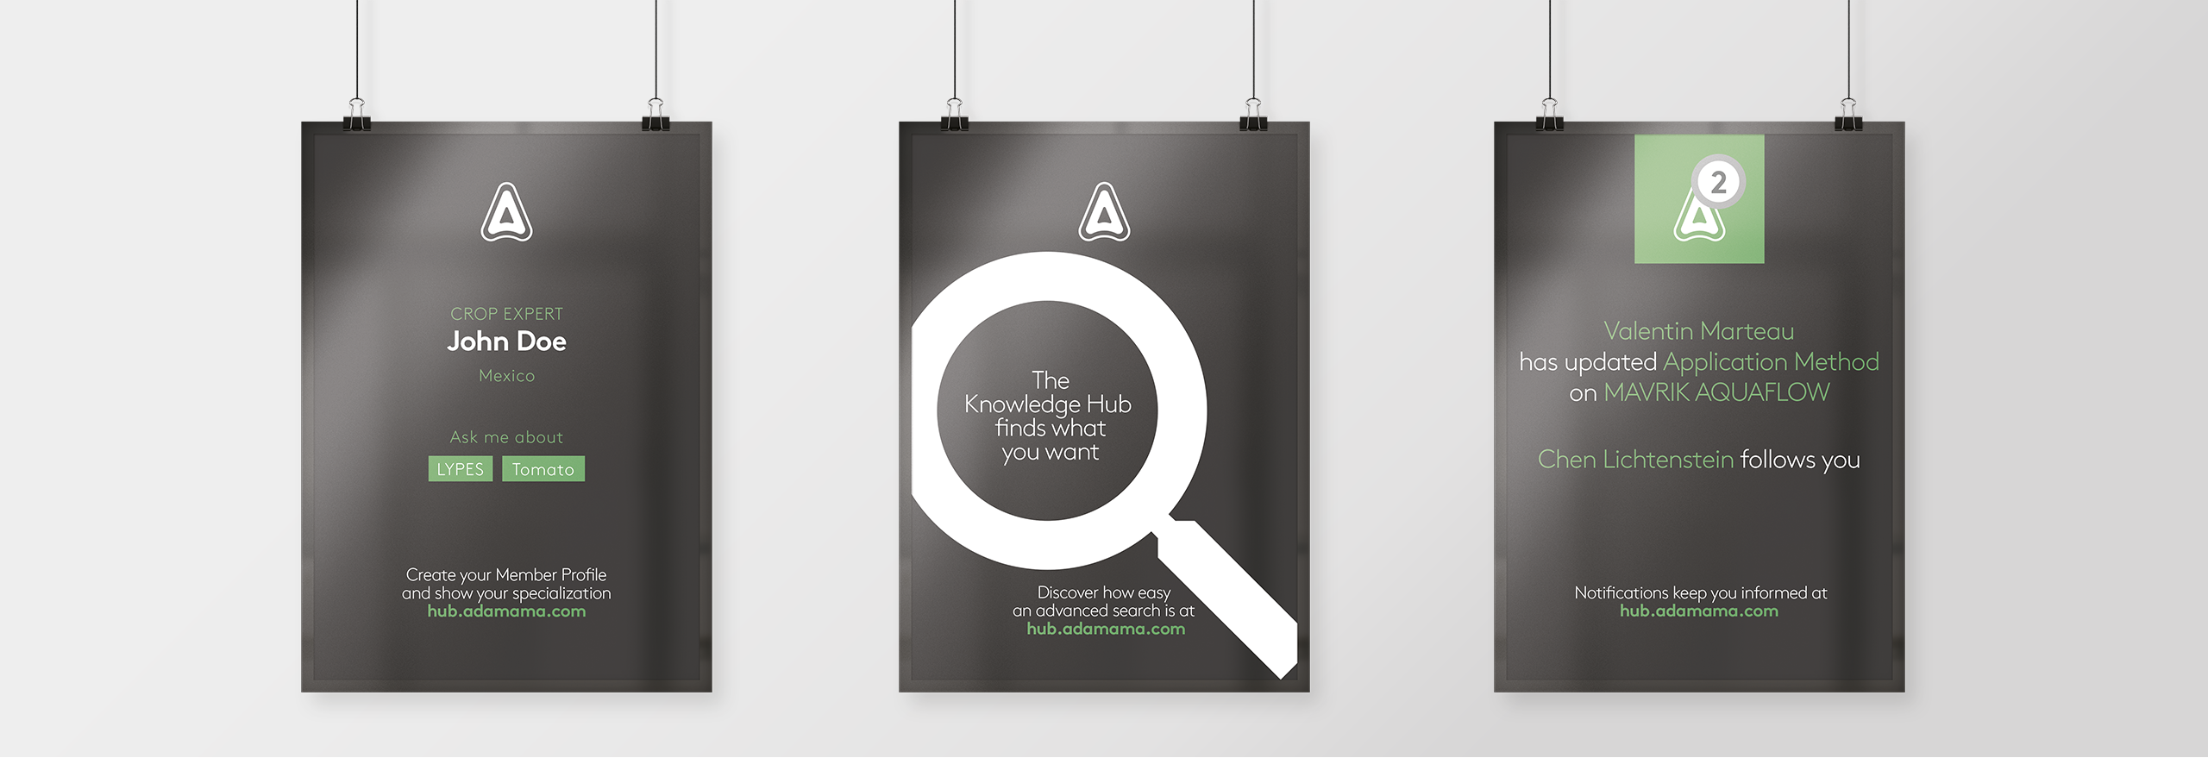
ADAMA
KNOWLEDGE HUB – DESIGN FOR POSTERS

Slide 8
ADAMA
KNOWLEDGE HUB
KEY FACTS
TECHNOLOGY
PROJECT EXECUTION
Multi national project scope
Concept and Design of UI / UX (mobile & desktop)
Definition of user stories
Integration of Liferay & Neo4j
Implementation of custom portlets
Integration between internal, external & mobile
Worldwide onsite trainings for users
Liferay
Neo4j
JavaScript
HTML 5 & CSS 3
Spring
Gulp
Swift 3
Java 8
Time:
175 Consultant Months 10 Consultants
Project Phase(s):
Conception – Designing – Planning – Implementation – Support
Role(s):
Product Owner – Scrum Master – Project
Manager – Business Analyst – Software Architect – Software Engineer – Quality Manager

